Slide 1

Analyzing the Reviews of Amazon Fine Food Products

Slide 2
Problem Statement
Given various features in the dataset like Product_id, Customer_id, ProfileName, Helpfullness Numerator, Helpfullness Denomenator, Time, Review Summary, Review Text which are used to predict the Score for each review that was given by customer.

Slide 3
MACHINE LEARNING PROJECT LIFECYCLE
Business Understanding
Data Collection
Data Cleaning
Data Analysis
Data Visualization
Feature Engineering
Model Building
Model Evaluation
Model Deployment

Slide 4
Data Description
This dataset consists of reviews of fine foods from amazon. The data span a period of more than 10 years, including all ~500,000 reviews up to October 2012. Reviews include product and user information, ratings, and a plain text review. It also includes reviews from all other Amazon categories.

Slide 5
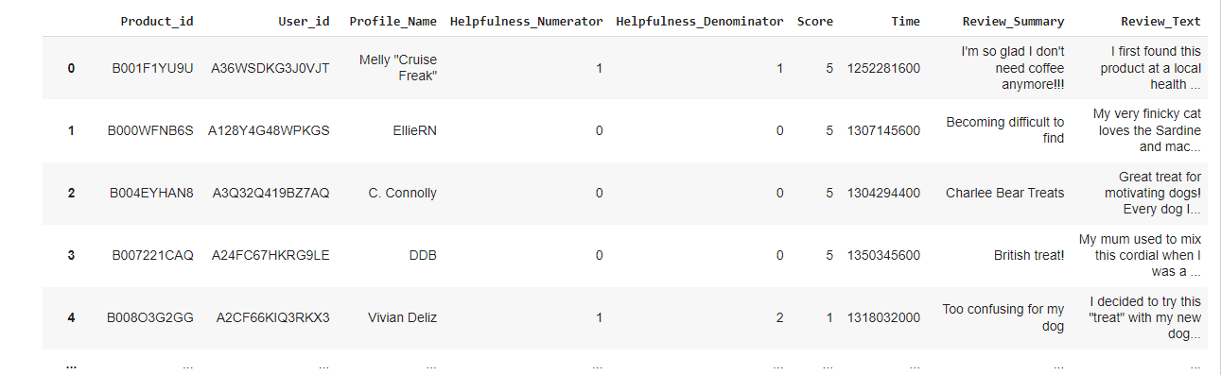
Cleaned Data

Slide 6
Exploratory Data Analysis
Data Cleaning Steps:
• Check for Duplicates .
• Drop the duplicates.
• Identifying missing values .
•Drop unnecessary values.

Slide 7
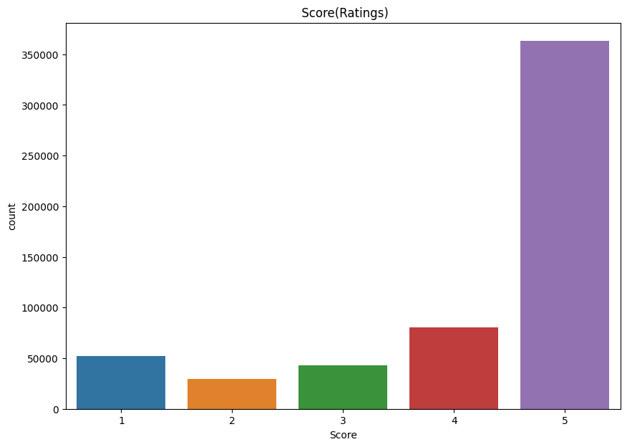
Data Visualization
If Reviews score>3 , positive
Score <3 , negative

Slide 8
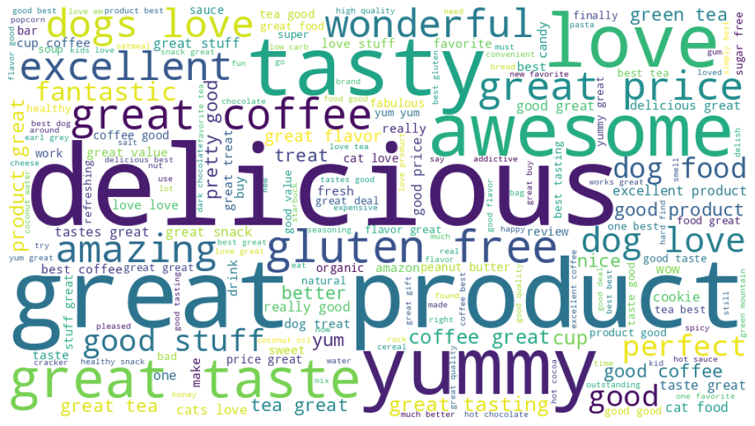
Data visualization
Word cloud of positive review

Slide 9
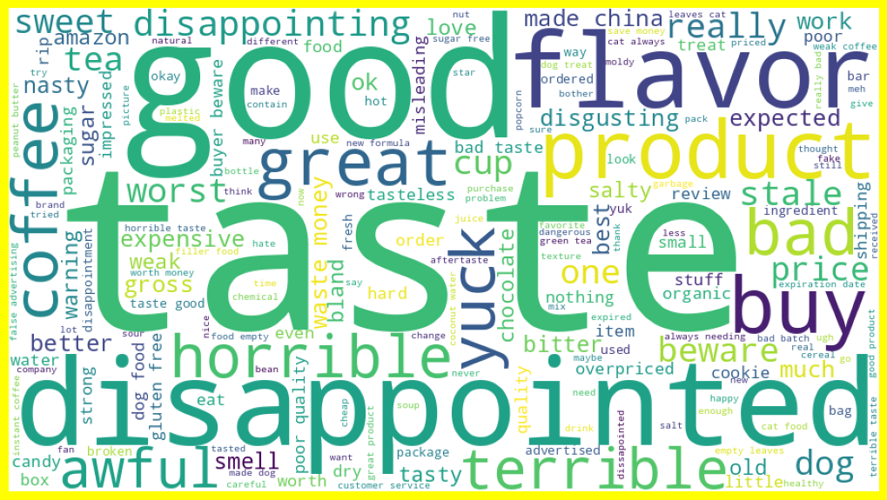
Data visualization
Convert lower case
Using stop words to stop all
Unnecessary words
Create word cloud of negative reviews.

Slide 10
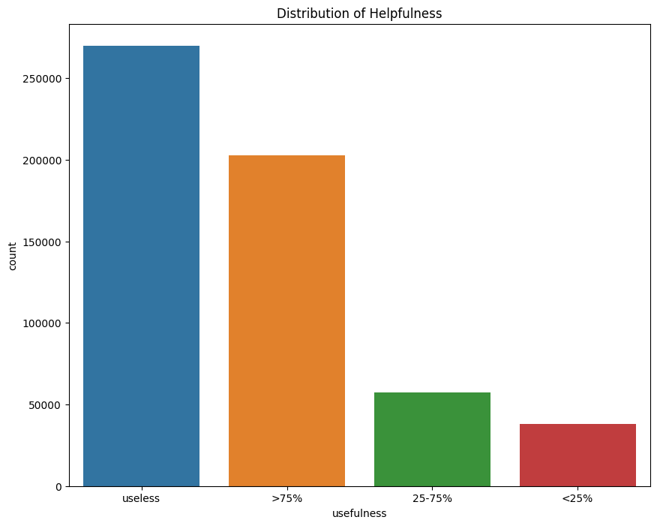
Data visualization
Usefulness is ratio of helpfulness numerator and helpfulness denominator
If usefulness is greater then 0.75% then >75%
If usefulness in between 0.25 to 0.75 then 25-75%
If usefulness less then 0.25 then <25%
Other than this range all are useless

Slide 11
Data preprocessing
Reading the data and removing unwanted columns
Done Train Test Split
Taking the 'Text' column in separate list
Converting the whole list to lower-case
Removing HTML Tags from strings
Removing Special Characters from strings
Removing Stop words, Stemming, Lemmatizing
Stemming & Lemmatizing on train and test Features

Slide 12
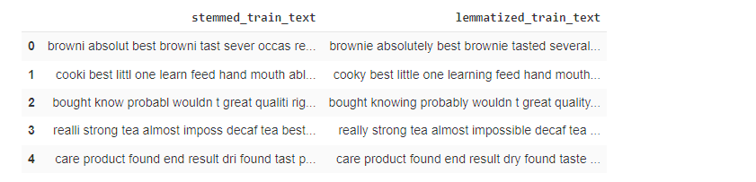
Stemming / Lemmatizing on Train Features

Slide 13
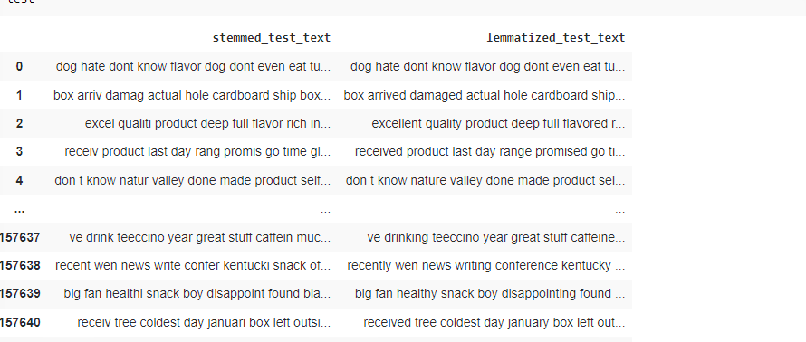
Stemming / Lemmatizing on Test Features

Slide 14
Building and evaluating the model
Logistic Regression, Naive Bayes Classifier, Decision Tree Classifier, RandomForest classifier, Kneighbors Classifier Model used
Using of Logistic Regression Accuracy is high
In Evaluation part calculate Accracy,precision,recall,f1-score for each and every Algorithm

Slide 15
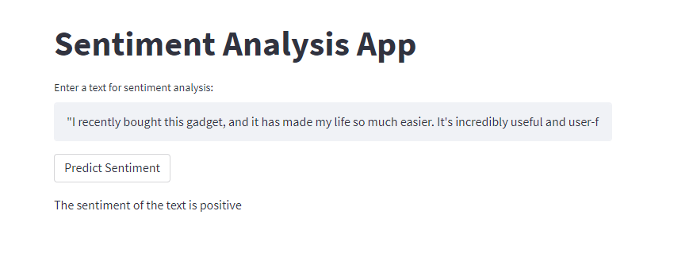
streamlit Application/check text positive or negative

Slide 16


Slide 17

THANK YOU

